Slide 1
Presented By:- _______
Submitted To:-_________
College name:-_______

Slide 2
Intoduction
Social media has become an integral part of the people in 21st century. Due to rapid progress in Information &Technology sector, people have access to any kind of information at the click of a button. Moreover, with the invent of smart-phones and 4G networks, even people from the remote areas are getting connected to Tier 1 and Tier 2 cities. With the growing population in countries like India, it has led to tremendous growth in the number of people using social networks.
Social networks like Facebook, WhatsApp, Twitter, etc. has eliminated the gap between lives of people. One of the
reasons to use these social networks to know the current
happenings around them and to express their views and
suggestions in the form of likes, share, tweets, polls, email,
etc. Communication via social media is done in the
form of text, image, audio and video which contains
information and consumes space, memory and Internet
bandwidth.

Slide 3
Introduction to Machine Learning
Machine learning is a subfield of artificial intelligence (AI). The goal of machine learning generally is to understand the structure of data and fit that data into models that can be understood and utilized by people. Although machine learning is a field within computer science, it differs from traditional computational approaches. In traditional computing, algorithms are sets of explicitly programmed instructions used by computers to calculate or problem solve. Machine learning algorithms instead allow for computers to train on data inputs and use statistical analysis in order to output values that fall within a specific range. Because of this, machine learning facilitates computers in building models from sample data in order to automate decision-making processes based on data inputs. Any technology user today has benefitted from machine learning. Facial recognition technology allows social media platforms to help users tag and share photos of friends.

Slide 4
Python
You don’t need to pay charges to install and use Python – it is open-source. What this means is that the source code of Python is freely available to the public. You can download it from Python’s official website. Not only that, Python supports the FLOSS (Free/Libre and Open Source Software) model, which means you can also change it and distribute it. This allows the Python community to tweak it and improve its features continuously.
It is a high-level language
Since Python is a high-level language, you need not remember its system architecture, not do you need to perform memory management. This feature contributes to Python’s user-friendliness.

Slide 5
Tkinter Python Library
Tkinter ("Tk Interface")is python's standard cross-platform package for creating graphical user interfaces (GUIs). It provides access to an underlying Tcl interpreter with the Tk toolkit, which itself is a cross-platform, multilanguage graphical user interface library.Tkinter isn't the only GUI library for python, but it is the one that comes standard. Additional GUI libraries that can be used with python include wxPython, PyQt, and kivy.Tkinter's greatest strength is its ubiquity and simplicity. It works out of the box on most platforms (linux, OSX, Windows), and comes complete with a wide range of widgets necessary for most common tasks (buttons, labels, drawing canvas, multiline text, etc).As a learning tool, tkinter has some features that are unique among GUI toolkits, such as named fonts, bind tags, and variable tracing.

Slide 6
How To Build a Machine Learning Classifier in Python with Scikit
Implement a simple machine learning algorithm in Python using Scikit-learn, a machine learning tool for Python. Using a database of breast cancer tumor information, you’ll use a Naive Bayes (NB) classifier that predicts whether or not a tumor is malignant or benign. By the end of this tutorial, you’ll know how to build your very own machine learning model in Python. Prerequisites To complete this tutorial, we’ll use Jupyter Notebooks, which are a useful and interactive way to run machine learning experiments. With Jupyter Notebooks, you can run short blocks of code and see the results quickly, making it easy to test and debug your code. To get up and running quickly, you can open up a web browser and navigate to the Try Jupyter website: jupyter.org/try. From there, click on Try Jupyter with Python, and you will be taken to an interactive Jupyter Notebook where you can start to write Python code.

Slide 7
How To Build a Neural Network to Recognize Handwritten Digits with TensorFlow
Neural networks are used as a method of deep learning, one of the many subfields of artificial intelligence. They were first proposed around 70 years ago as an attempt at simulating the way the human brain works, though in a much more simplified form. Individual ‘neurons’ are connected in layers, with weights assigned to determine how the neuron responds when signals are propagated through the network.

Slide 8
Pandas In Python
Pandas is an open source Python package that is most widely used for data science/data analysis and machine learning tasks. It is built on top of another package named Numpy, which provides support for multi-dimensional arrays. As one of the most popular data wrangling packages, Pandas works well with many other data science modules inside the Python ecosystem, and is typically included in every Python distribution, from those that come with your operating system to commercial vendor distributions like ActiveState’s Active Python.

Slide 9
Keras In Python
Keras is high-level API wrapper for the low-level API, capable of running on top of TensorFlow, CNTK, or Theano. Keras High-Level API handles the way we make models, defining layers, or set up multiple input-output models. In this level, Keras also compiles our model with loss and optimizer functions, training process with fit function. Keras in Python doesn't handle Low-Level API such as making the computational graph, making tensors or other variables because it has been handled by the "backend" engine.

Slide 10
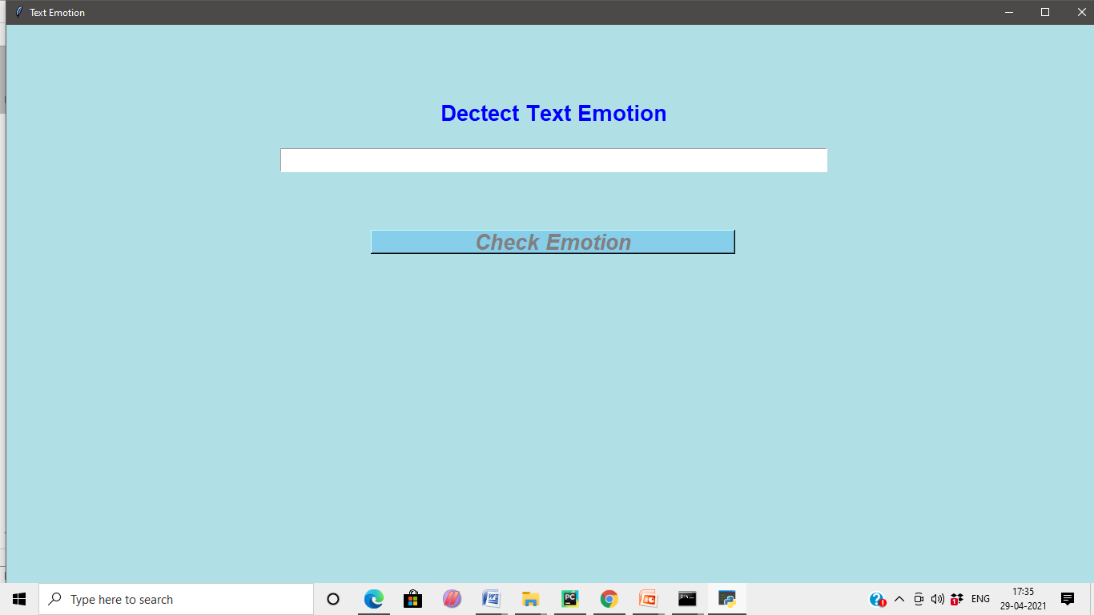

Slide 11
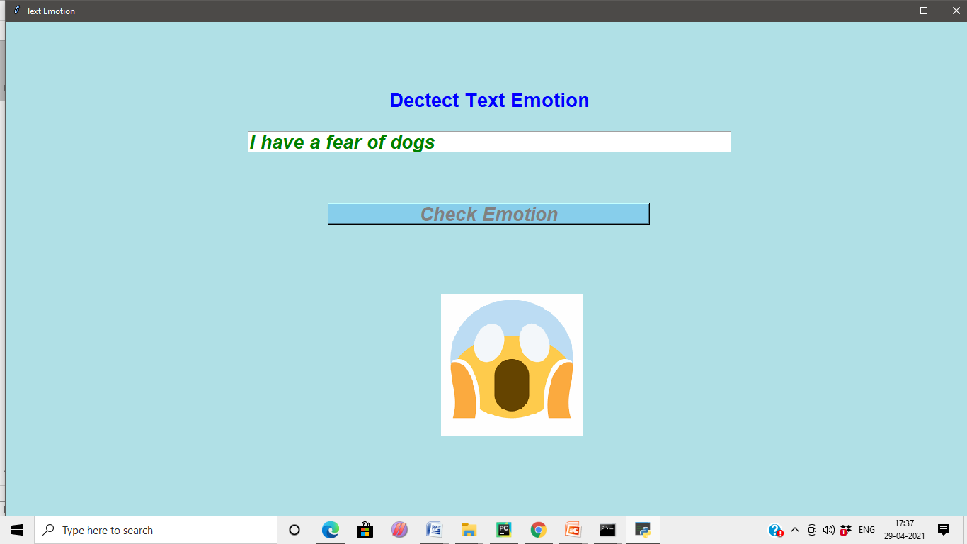

Slide 12
